Slide 1


DATA PRESENTATIONS
MATH30-6
Probability and Statistics
Notes:
Week 1 Day 1 Linear Equations (Algebra and Trigonometry, Young 2nd Edition, page 90-99).

Slide 2
OBJECTIVES
The students at the end of the lesson are expected to:
Identify and learn various ways of presenting data
Describe data through tables, graphs and charts
Describe and interpret data presented in various charts
Practice different ways of presenting data

Slide 3
TYPES OF DATA PRESENTATION
Textual Form
  Data presentation using sentences and paragraphs in describing data
Tabular Form
  Data presentation that uses tables arranged in rows and columns for various parameter
Graphical Form
  Pictorial representation of data

Slide 4
Grouped and Ungrouped Data
Ungrouped Data
  Data points are treated individually
Grouped Data
  Data points are treated and grouped according to categories.

Slide 5
Data Presentation
Stem and Leaf Plot
  Stem and Leaf plot is one way of summarizing ungrouped data. This table would have two columns, one for the stem and the other for the leaves. A set of two digit numbers can be split apart into two. The tens digit will be the set aside for the stem and the ones digit is for the leaves.
Example 1
Express the following data as a stem and leaf plot with the tens digit as the stem and the ones digit as the leaves:
12, 23, 12, 11, 10, 25, 29, 39, 31, 43, 42, 54,
53, 53, 56, 57, 56, 67, 54, 65, 76, 76, 75, 74

Slide 6
Data Presentation
Frequency Distribution Table
  Numerous data can be analyzed by grouping the data into different classes with equal class intervals and determining the number of observations that fall within each class. This procedure is done to lessen work done in treating each data individually by treating the data by group.

Slide 7
Frequency Distribution Table
♠ CLASS LIMITS. It is the smallest and the largest values that fall within the class interval. The class limit is taken with equal number of significant figures as the given data.
♠ CLASS BOUNDARIES are more precise expression of the class interval. It is usually one significant digit more than the class limit. This is acquired as the midpoint of the upper limit of the lower class and the lower limit of the upper class.
♠ FREQUENCY is the number of observations falling within a particular class. A tally is usually presented before the frequency in order to show the manual counting of the data being posted.
♠ CLASS WIDTH is the numerical difference between the upper and lower class boundaries of a class interval

Slide 8
Frequency Distribution Table
♠ CLASS MARK is the middle element of the class. It represents the entire class and it is usually symbolized by x.
♠ CUMULATIVE FREQUENCY is the number of observations that has been accumulated either from the highest class interval to the lower class interval as in the greater than cumulative frequency (>cf), and if on the reverse order starting from the lowest class interval, it is called the less than cumulative frequency(<cf).
♠ RELATIVE FREQUENCY on the other hand is the percentage frequency of the class with respect to the total population. This data will be especially useful in presenting pie charts representing the distribution on how the population is split into classes.

Slide 9


Steps in Creating FDT
1. Decide on the number of class intervals required.
The number of classes required is on the freedom of who will be analyzing the data. Usually the number of classes extends from 7 to 20 classes. Ideally, classes would have intervals of multiples 5 but dependent on the actual set of data the class width might be different. Various formulae for standardizing the number of class intervals are as follows:
Square Root Principle
The number of classes can be assigned as the square root of the size of the population hence the formula:
where k is the number of class interval and
N is the total number of data.
Sturge’s Formula
A more acceptable formula for determining the number of classes is

Slide 10
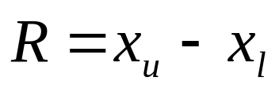
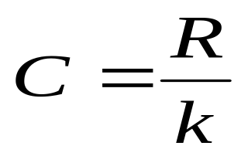
Steps in Creating FDT
2. Determine the range.
where R is the range of the data
x_{u} is the highest data
x_{l} is the lowest data
3. Determine the class width (C) of each class intervals by dividing the range by the desired number of class interval.

Slide 11
Steps in Creating FDT
4. Determine the lower and upper class limits of each class
5. Determine the number of observations falling in each class interval and compute for the other values.

Slide 12
Example:
Suppose that the following data are the height of randomly selected students enrolled in BS ECE (in cm)
160 | 160 | 170 | 152 | 175
161 | 152 | 165 | 152 | 151
157 | 152 | 157 | 162 | 161
170 | 149 | 170 | 162 | 170
158 | 162 | 167 | 149 | 172
172 | 162 | 172 | 163 | 177

Slide 13
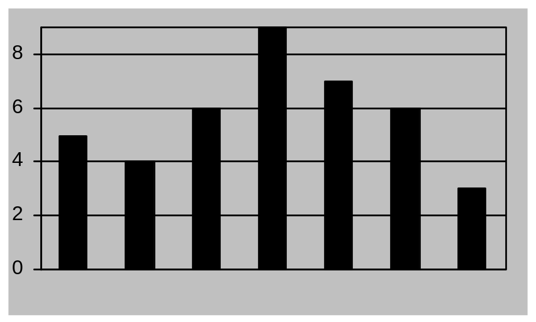
Data Presentations
Bar Chart
Plotting the class marks (x-axis) versus the frequency (y-axis) of the distribution gives
f
Class Marks

Slide 14
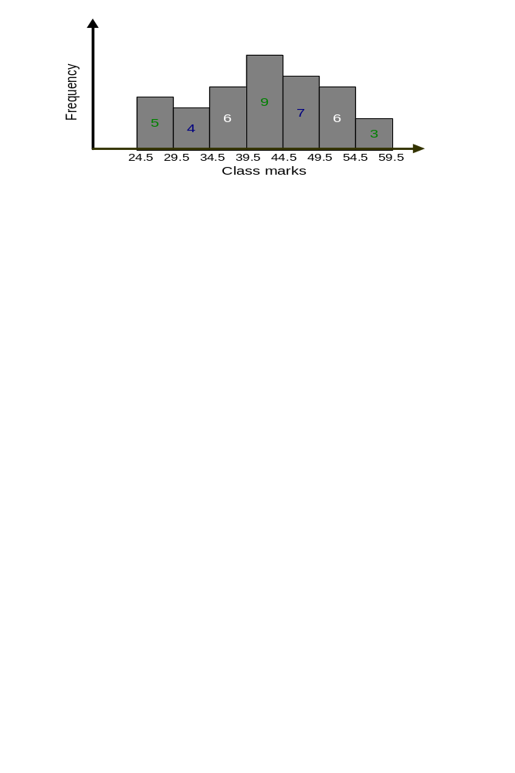
Data Presentations
Histogram
Plotting the class boundaries (x-axis) versus the frequency (y-axis) of the distribution gives
Class Boundaries

Slide 15
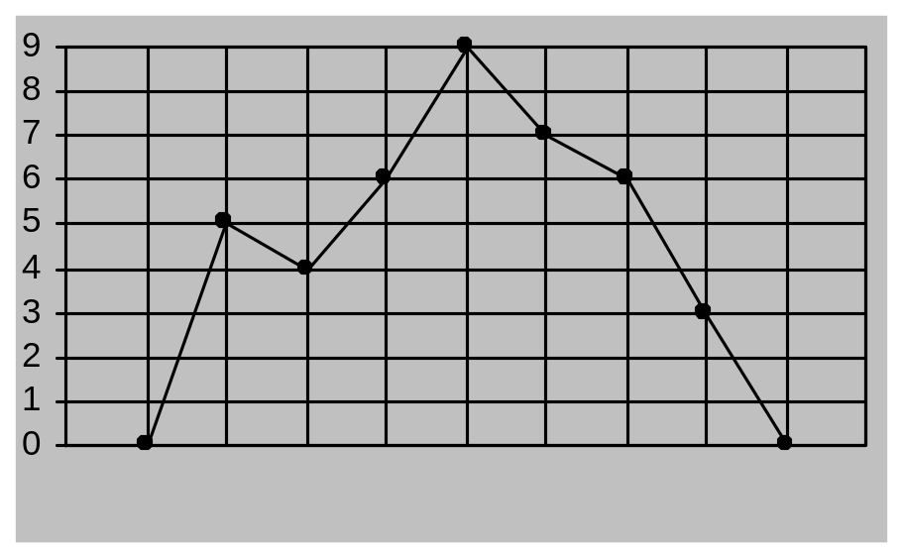
Data Presentations
Frequency Polygon
Plotting the class marks (x-axis) versus the class frequency (y-axis) of the distribution gives
f
Class Marks

Slide 16
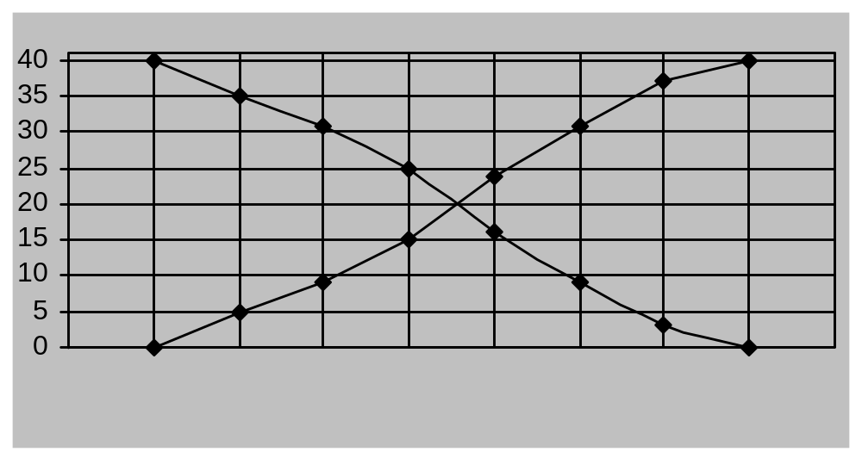
Data Presentations
Ogive
Plotting the class boundary along the x-axis and the cumulative frequency along the y-axis will yield
cf
Class Boundary

Slide 17
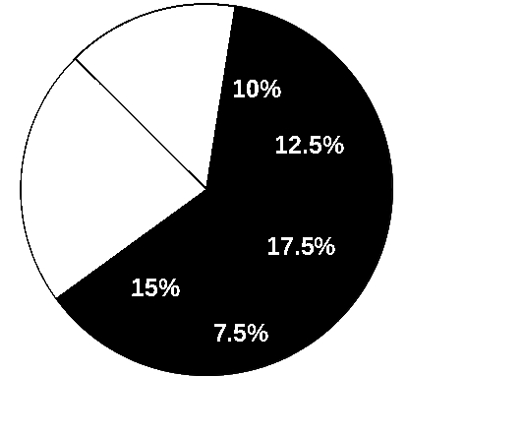
Data Presentations
Pie Chart

